Slide 2
Instyle engaged Marshall Day Acoustics to produce two audio simulations demonstrating how reverberation can be controlled in a classroom with Ecoustic wall panels, ceiling tiles + baffles

Slide 3
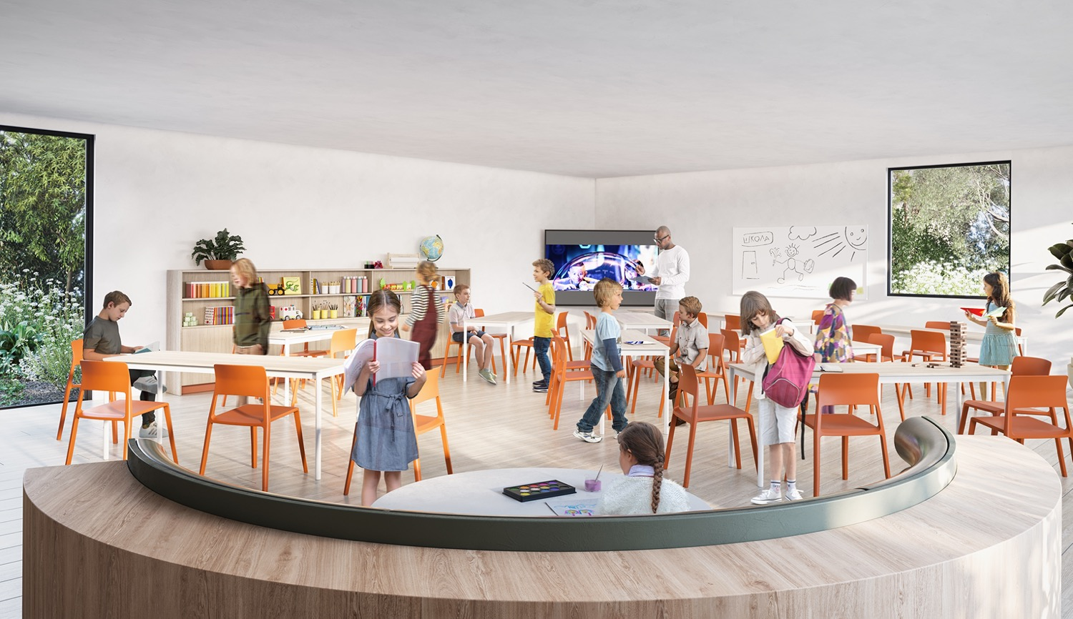

Before Acoustic Treatment
Reverberation Time 1.17 seconds
Painted plasterboard
Glazed windows + doors
17sqm approx.
Timber floor
on joists
Primary School Classroom
Area: 80sqm approx
10.3m x 7.8m
Ceiling Height: 2.7m

Slide 4
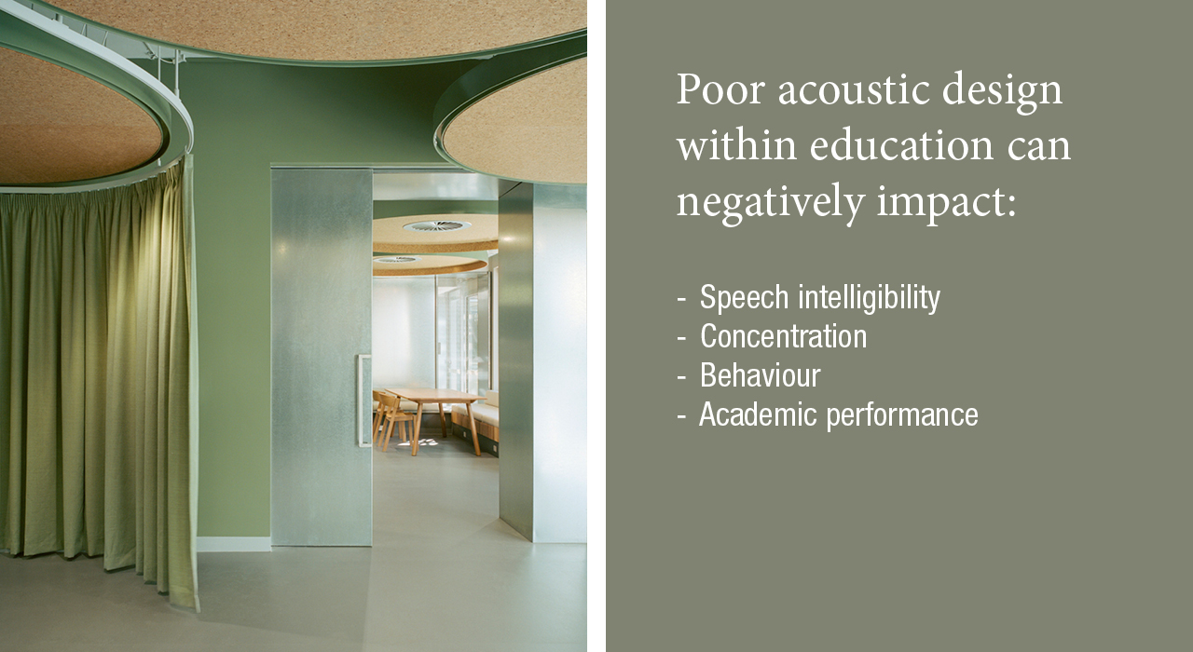

Slide 5
Recommendation for Education Interiors*
RT 0.4 - 0.8 seconds
Teaching spaces intended for students with learning difficulties + English as a second language should have reverberation times at the lower end of the range
*AS/NZS 2107:2016. Acoustics - Recommended design sound levels & reverberation times for building interiors: 0.4-0.8s RT
*AAAC (Association of Australasian Acoustical Consultants) Guideline for Educational Facilities: Recommendation - 0.4-0.6s RT

Slide 6
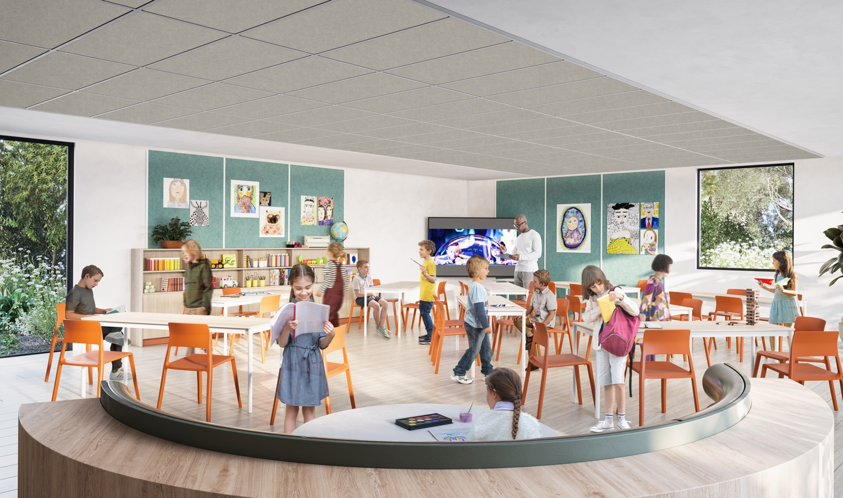
After Acoustic Treatment
Ecoustic Ceiling Tiles + Wall Panels
Reverberation Time 0.44 seconds
Ecoustic Ceiling Flats
12mm SC
40.1sqm
Ecoustic Felt Panel 13.5mm
40.2sqm
Primary School Classroom

Slide 7
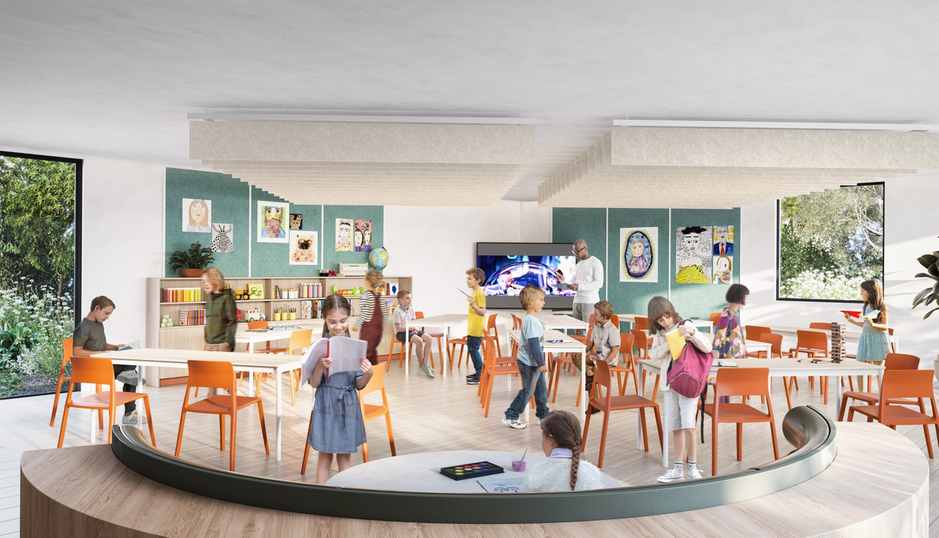
After Acoustic Treatment
Ecoustic Baffles + Wall Panels
Reverberation Time 0.43 seconds
Ecoustic Baffle 12mm SC 300mm @ 300mm centres
40.1sqm
Ecoustic Felt Panel 13.5mm
40.2sqm
Primary School Classroom

Slide 8
Classroom RT Calculations
Octave Band (Hz) | 63 | 125 | 250 | 500 | 1000 | 2000 | 4000 | 8000 | Mid-Frequency
Before Acoustic Treatment | 1.1 | 1.09 | 1.08 | 1.11 | 1.23 | 1.15 | 0.99 | 0.68 | 1.17
After Acoustic Treatment – Ecoustic Ceiling Tiles + Wall Panels | 0.62 | 0.6 | 0.52 | 0.45 | 0.43 | 0.39 | 0.37 | 0.31 | 0.44
After Acoustic Treatment – Ecoustic Baffles + Wall Panels | 0.92 | 0.83 | 0.55 | 0.43 | 0.42 | 0.41 | 0.39 | 0.32 | 0.43

Slide 9
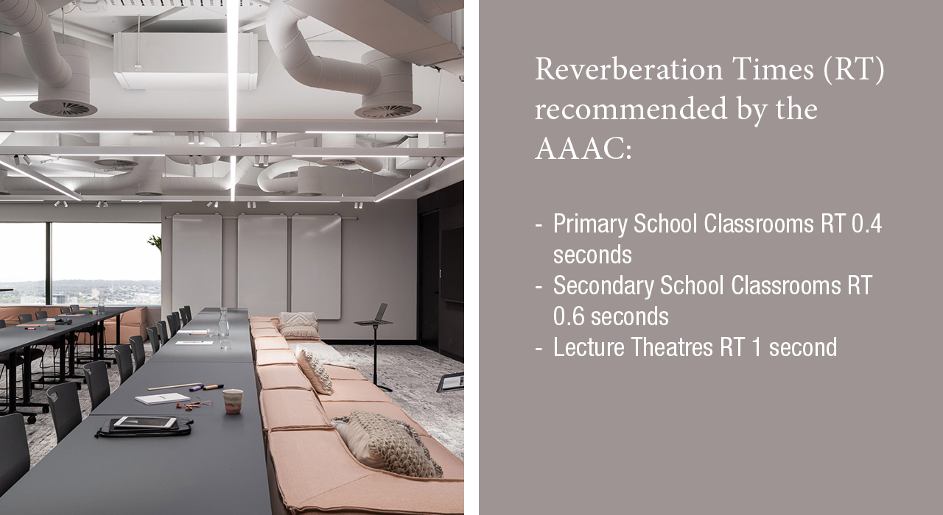

Slide 10
Acoustic calculations + auralisation audio
Yuxiao Chen
Marshall Day Acoustics

